Slide 1


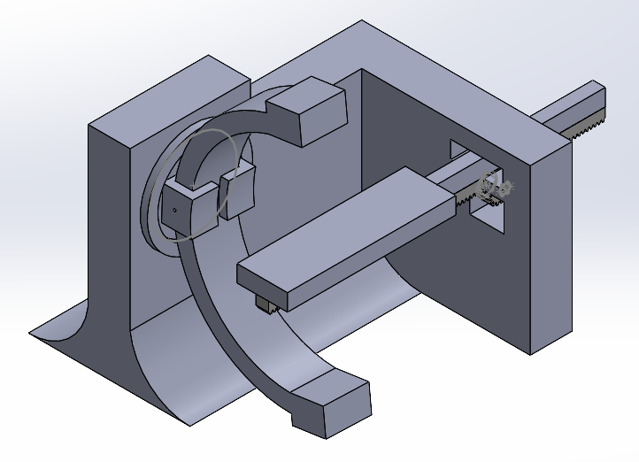
Fluoroscopy
James, armin, nate, pete, Sean, Hanro

Slide 2
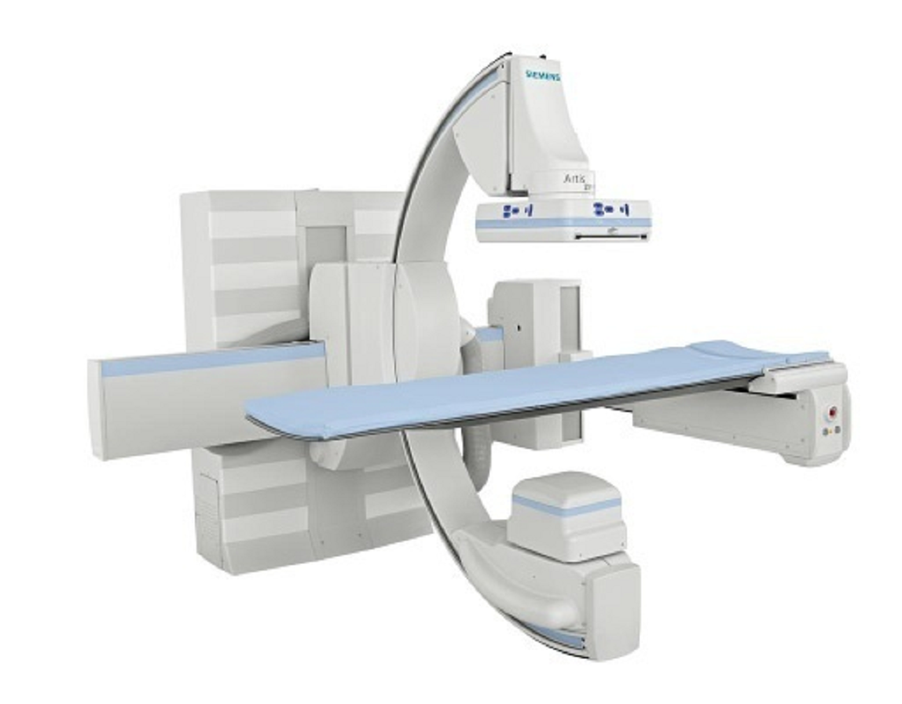
Medical Relevance
Fluoroscopy
Developed in late 19th Century
Popularized in 1960s
Uses
Surgery
Cardiology
Decline in use
Exposure based health concerns
Lack of Training
How can we combat these issues?

Slide 3
Demonstration!
Volunteer?

Slide 4
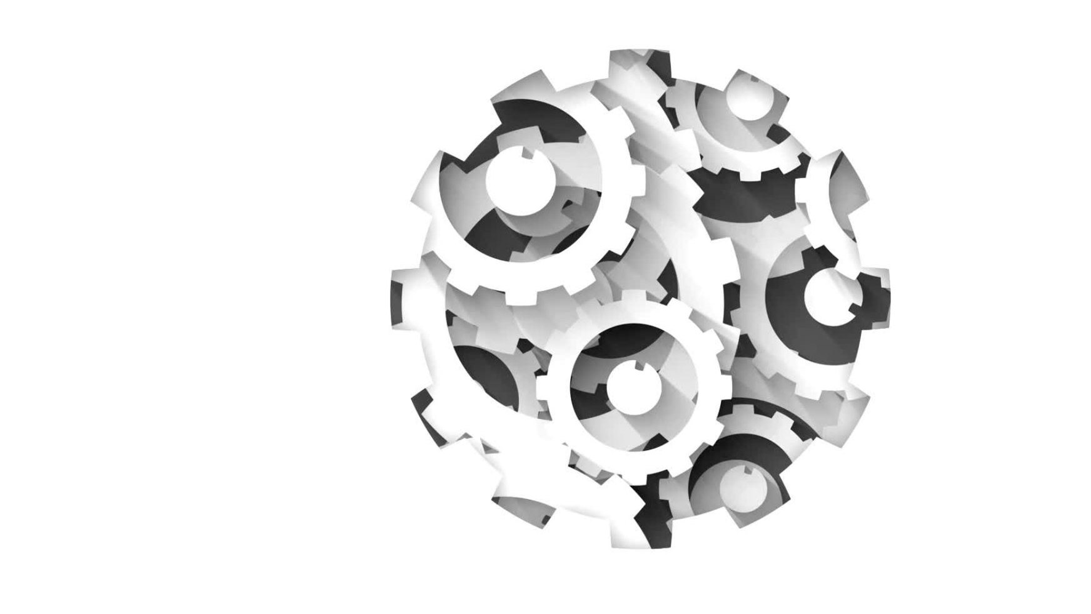
Mechanical Design

Slide 5
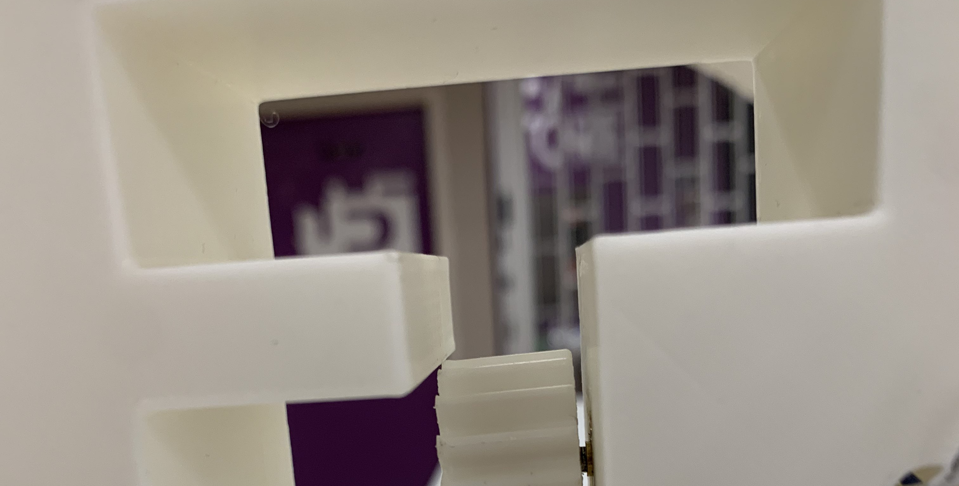
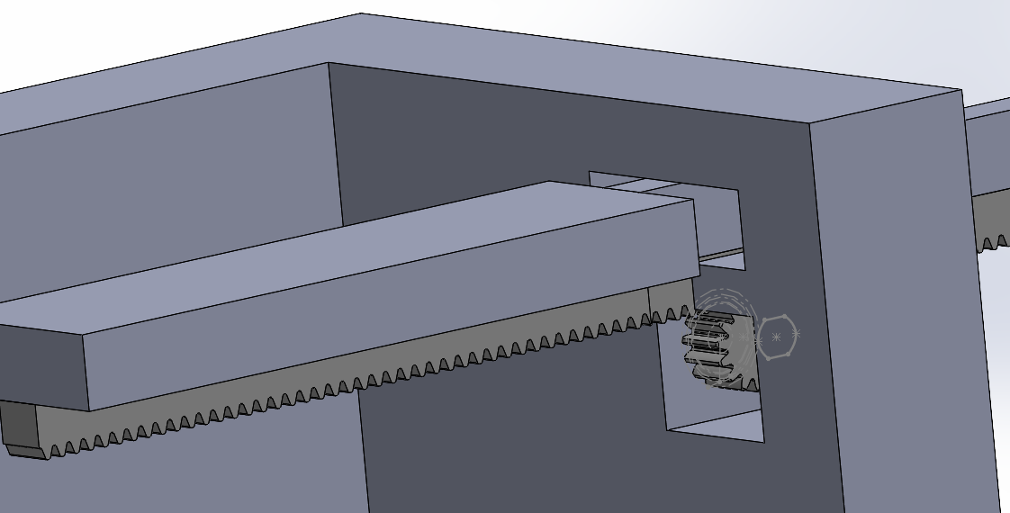
Bed Mechanism
Rack and Pinion
Small tooth number
Effective 3D-Printing
Less resolution
Small pitch diameter
Efficient use of space
High start-up torque / overpowers static friction
Friction fit to remove need for external support

Slide 6
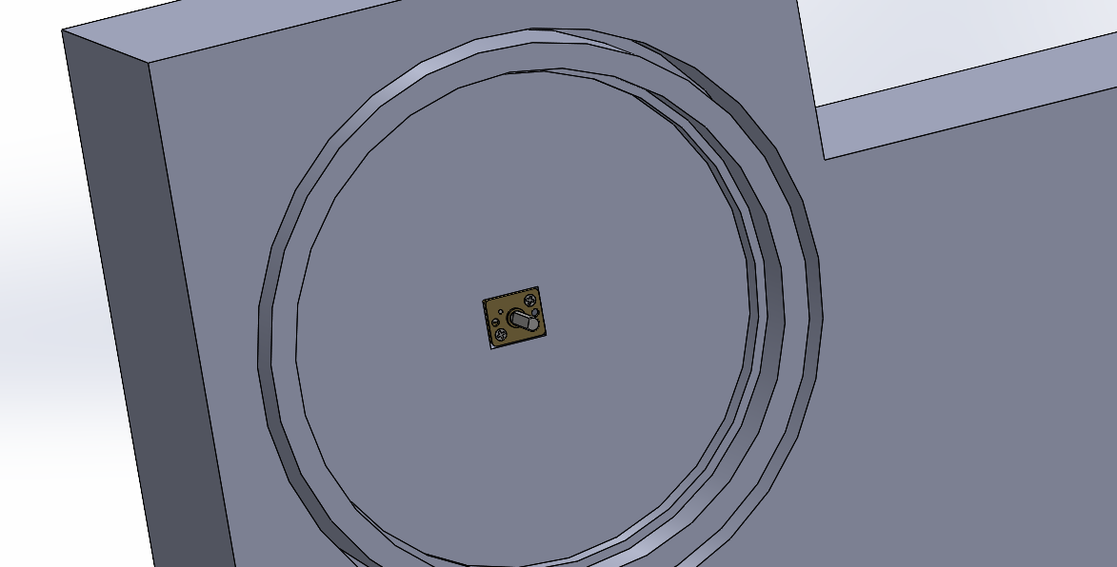
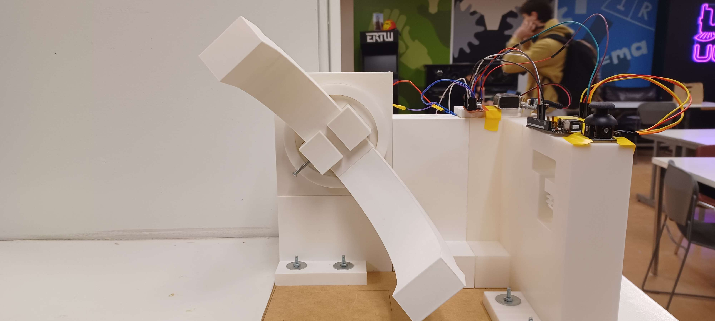
C-Arm Mechanism
Bearing
Reduces friction in rotational movement
Motor Fitting
Tolerancing issues
Set Screw System
Preferably more user friendly
Torque Capabilities
Low mass of C-arm = Low rotational inertia

Slide 7
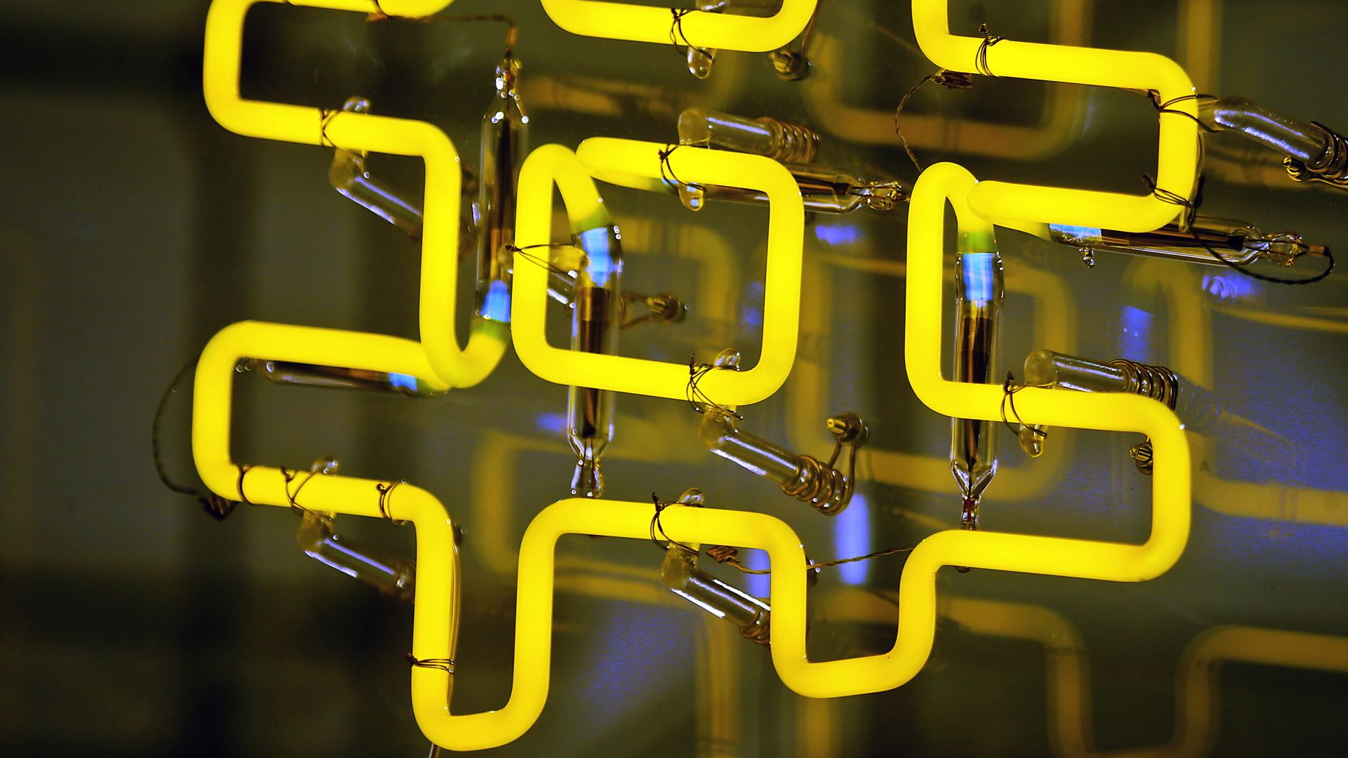
Electrical Design

Slide 8
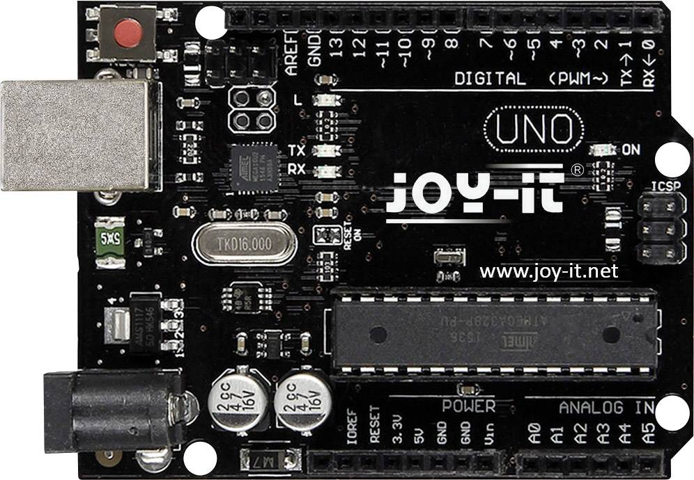
Micro Controller
An Arduino Uno was chosen due to it being readily available and easy to use by others should they want to replicate this project
MSEduino could also be used but not readily available to everyone and difficult to use at times (especially when uploading code)

Slide 9
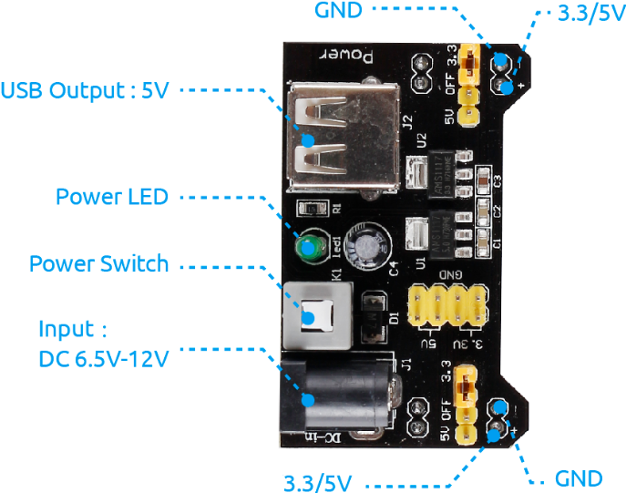
Power Distribution
A 9v battery is used as the power source for the circuit.
Motors are rated for 6v so a power supply module is used to step down the voltage to 5v while keeping current high.

Slide 10
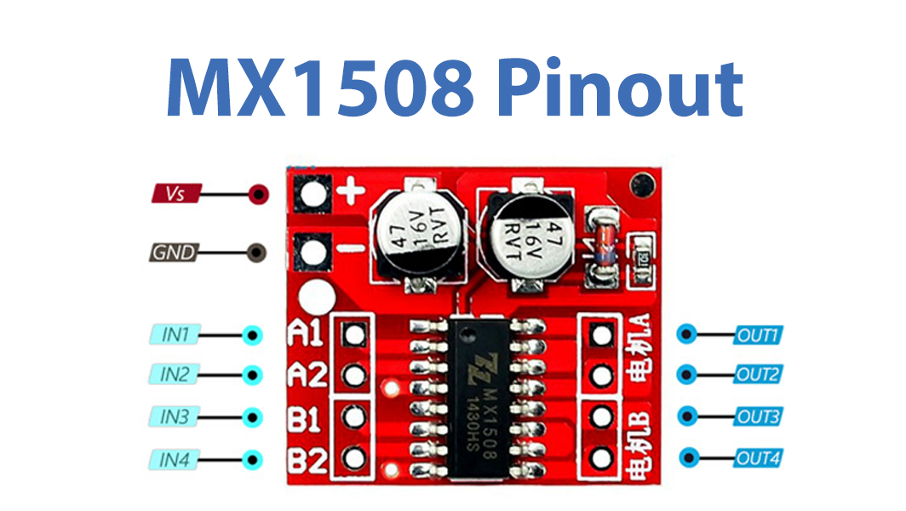
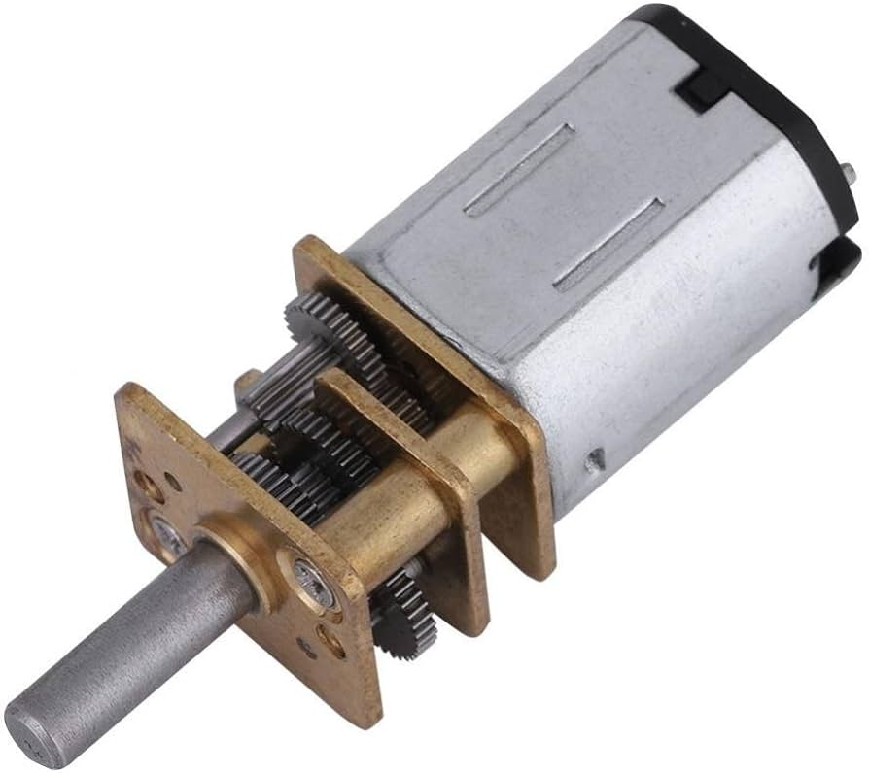
Motor Control
Two 6v DC motors are used to actuate both the C-Arm and bed.
The DC motors are controlled with a MX1508 motor controller to control direction.
DC motors vs Stepper motors for C arm

Slide 11

Software Design

Slide 12
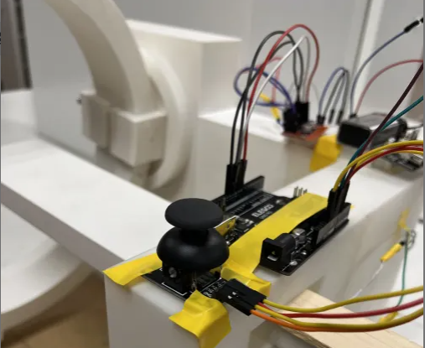
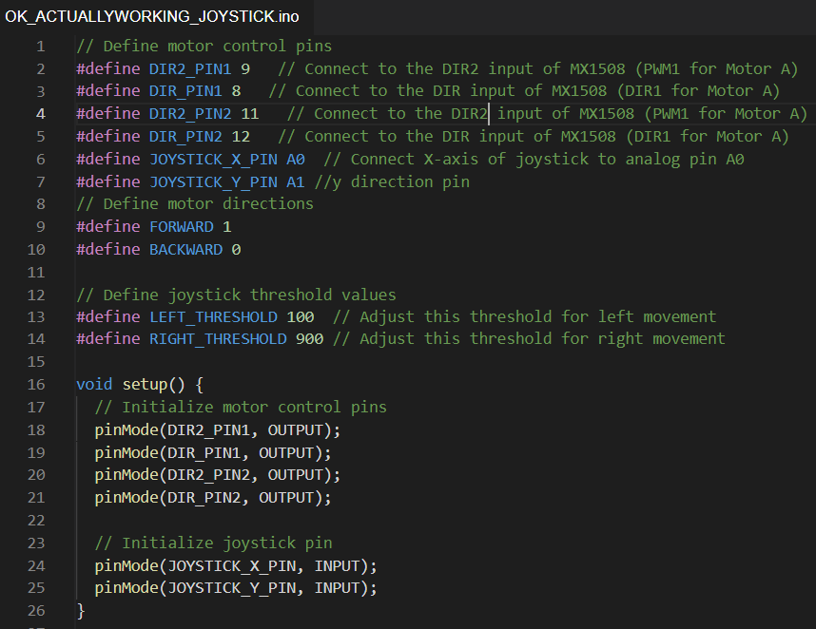
Arduino Software
In terms of pin outs 4 digital IO pins are required for control of the motor controller and 2 analog pins are used to input the joystick position to the Arduino
Joystick Y and X directions control each respective motors
Each joystick has movement threshold close to extreme positions

Slide 13
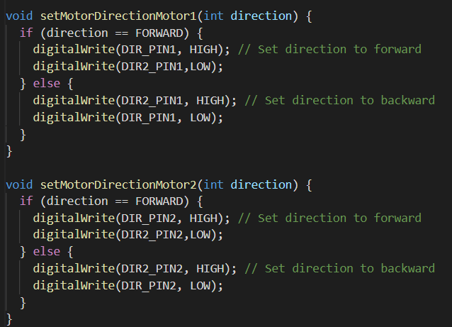
2 motor functions are called within the loop that set the directions of each motor
Directions are changed by setting respective direction pins to high or low

Slide 14
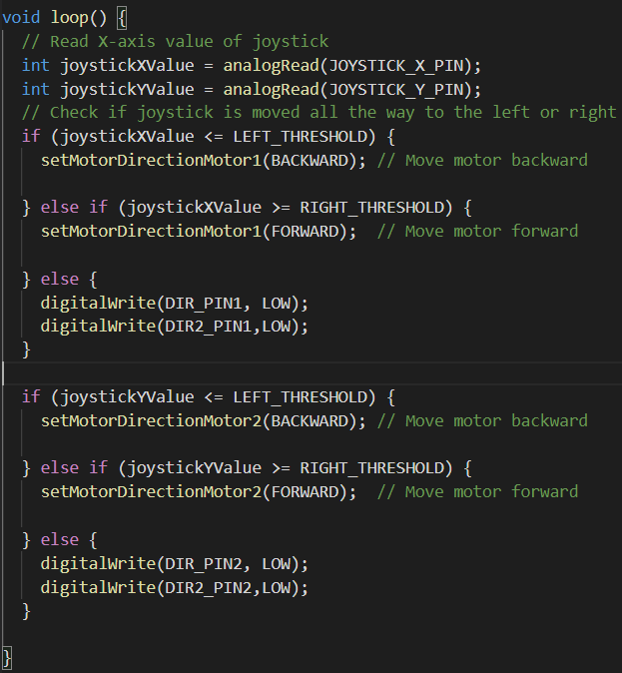
Joystick x and y values are read from the analog pins
Motor direction functions are called within the main loop when the joystick position in either the y or x axis pass the minimum and maximum thresholds

Slide 15
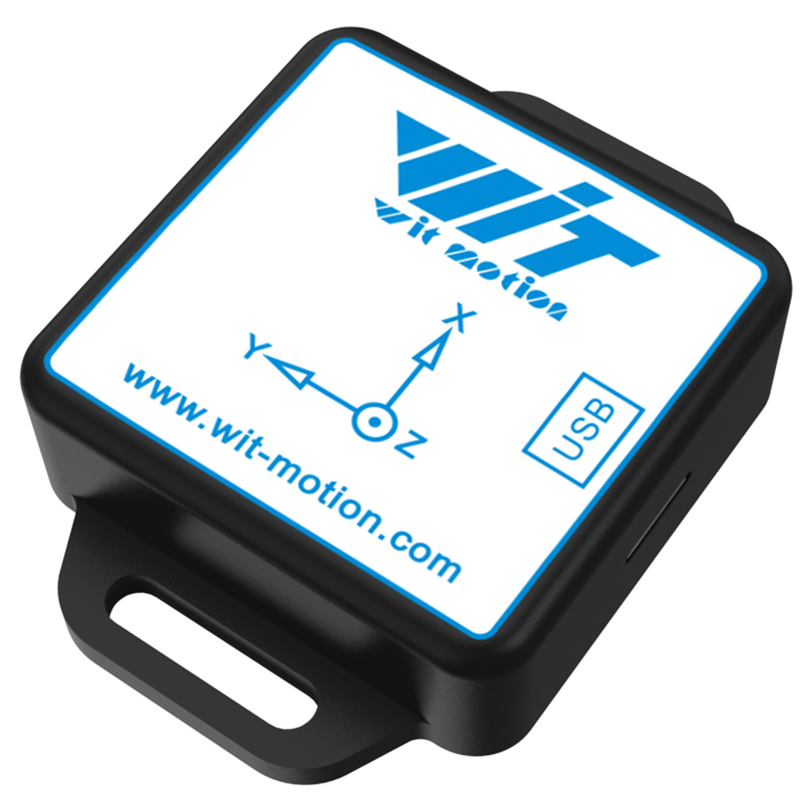
ACCELEROMETER
Issues with accelerometer
What if it worked?
Accelerometer communication
Position Based Actuation
Image Processing based on Position Data

Slide 16
Effective Prototype?
Good
Mechanical shape and design
General functionality
Scalable
Intuitive actuator interface (joystick)
Bad
No transducer for C-arm translation
Poor set screw design
Non-steady actuator performance
No feedback mechanism (accelerometer non-functioning)
No full-stop locking mechanism + poor resolution
Gears have wiggle

Slide 17
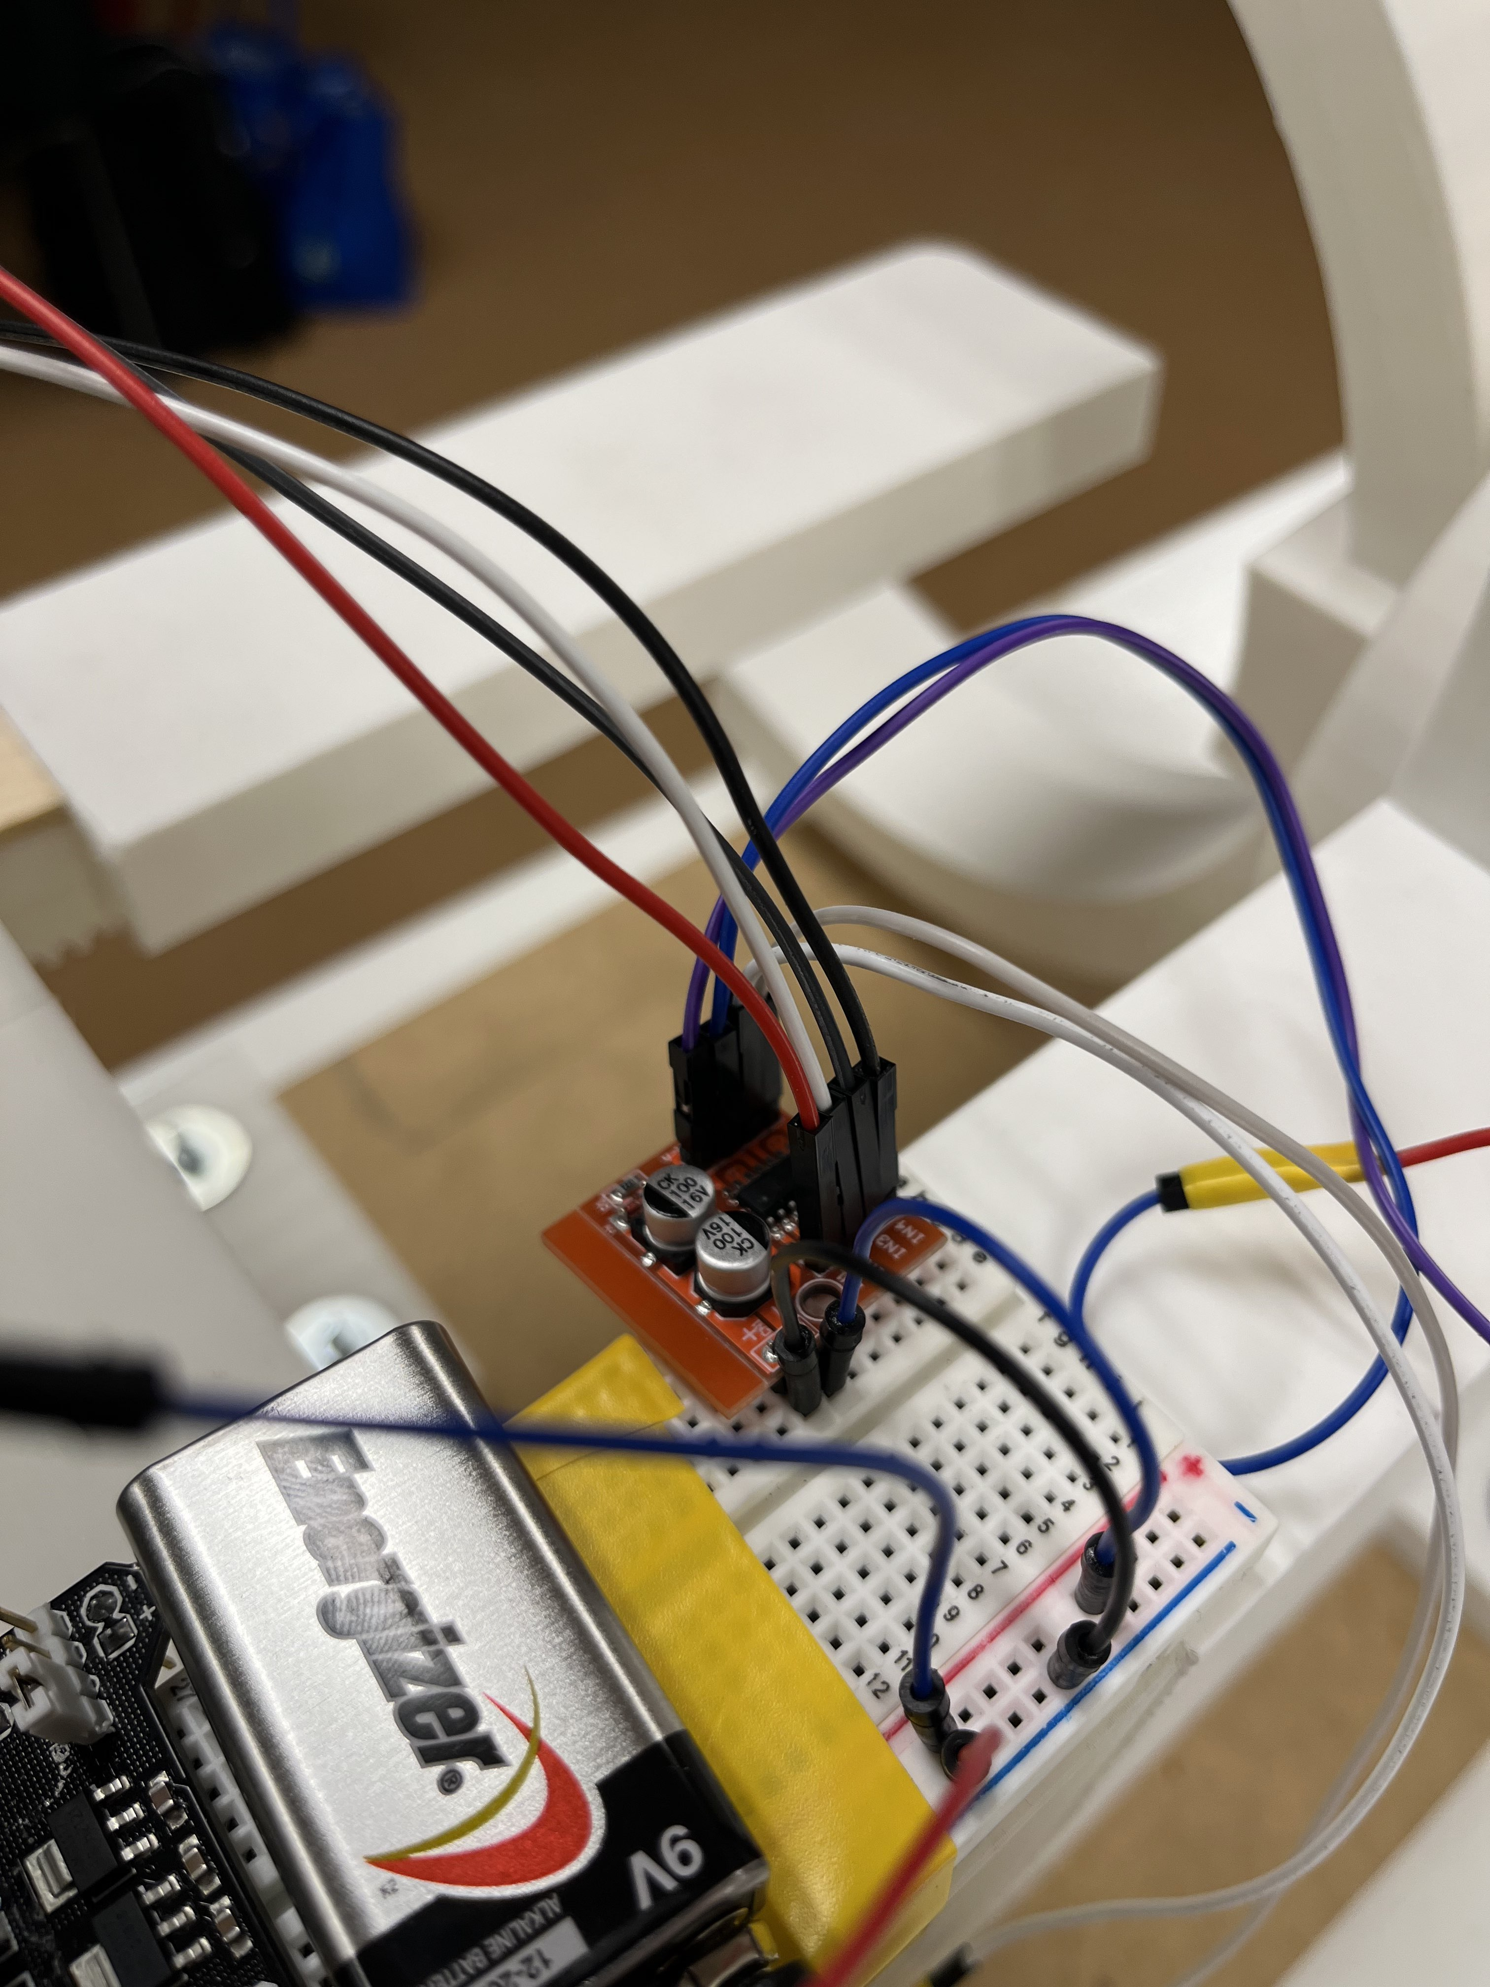
Project Lessons
Start early and plan for mistakes
Accelerometer issues
Design for tolerancing
Size and shape
Seak most efficient design
Lowest Infill to support prototype
Unnecessary material usage
Use what you already have
Don’t reinvent the wheel
Tried to create our own motor controller - we already have one!

Slide 18
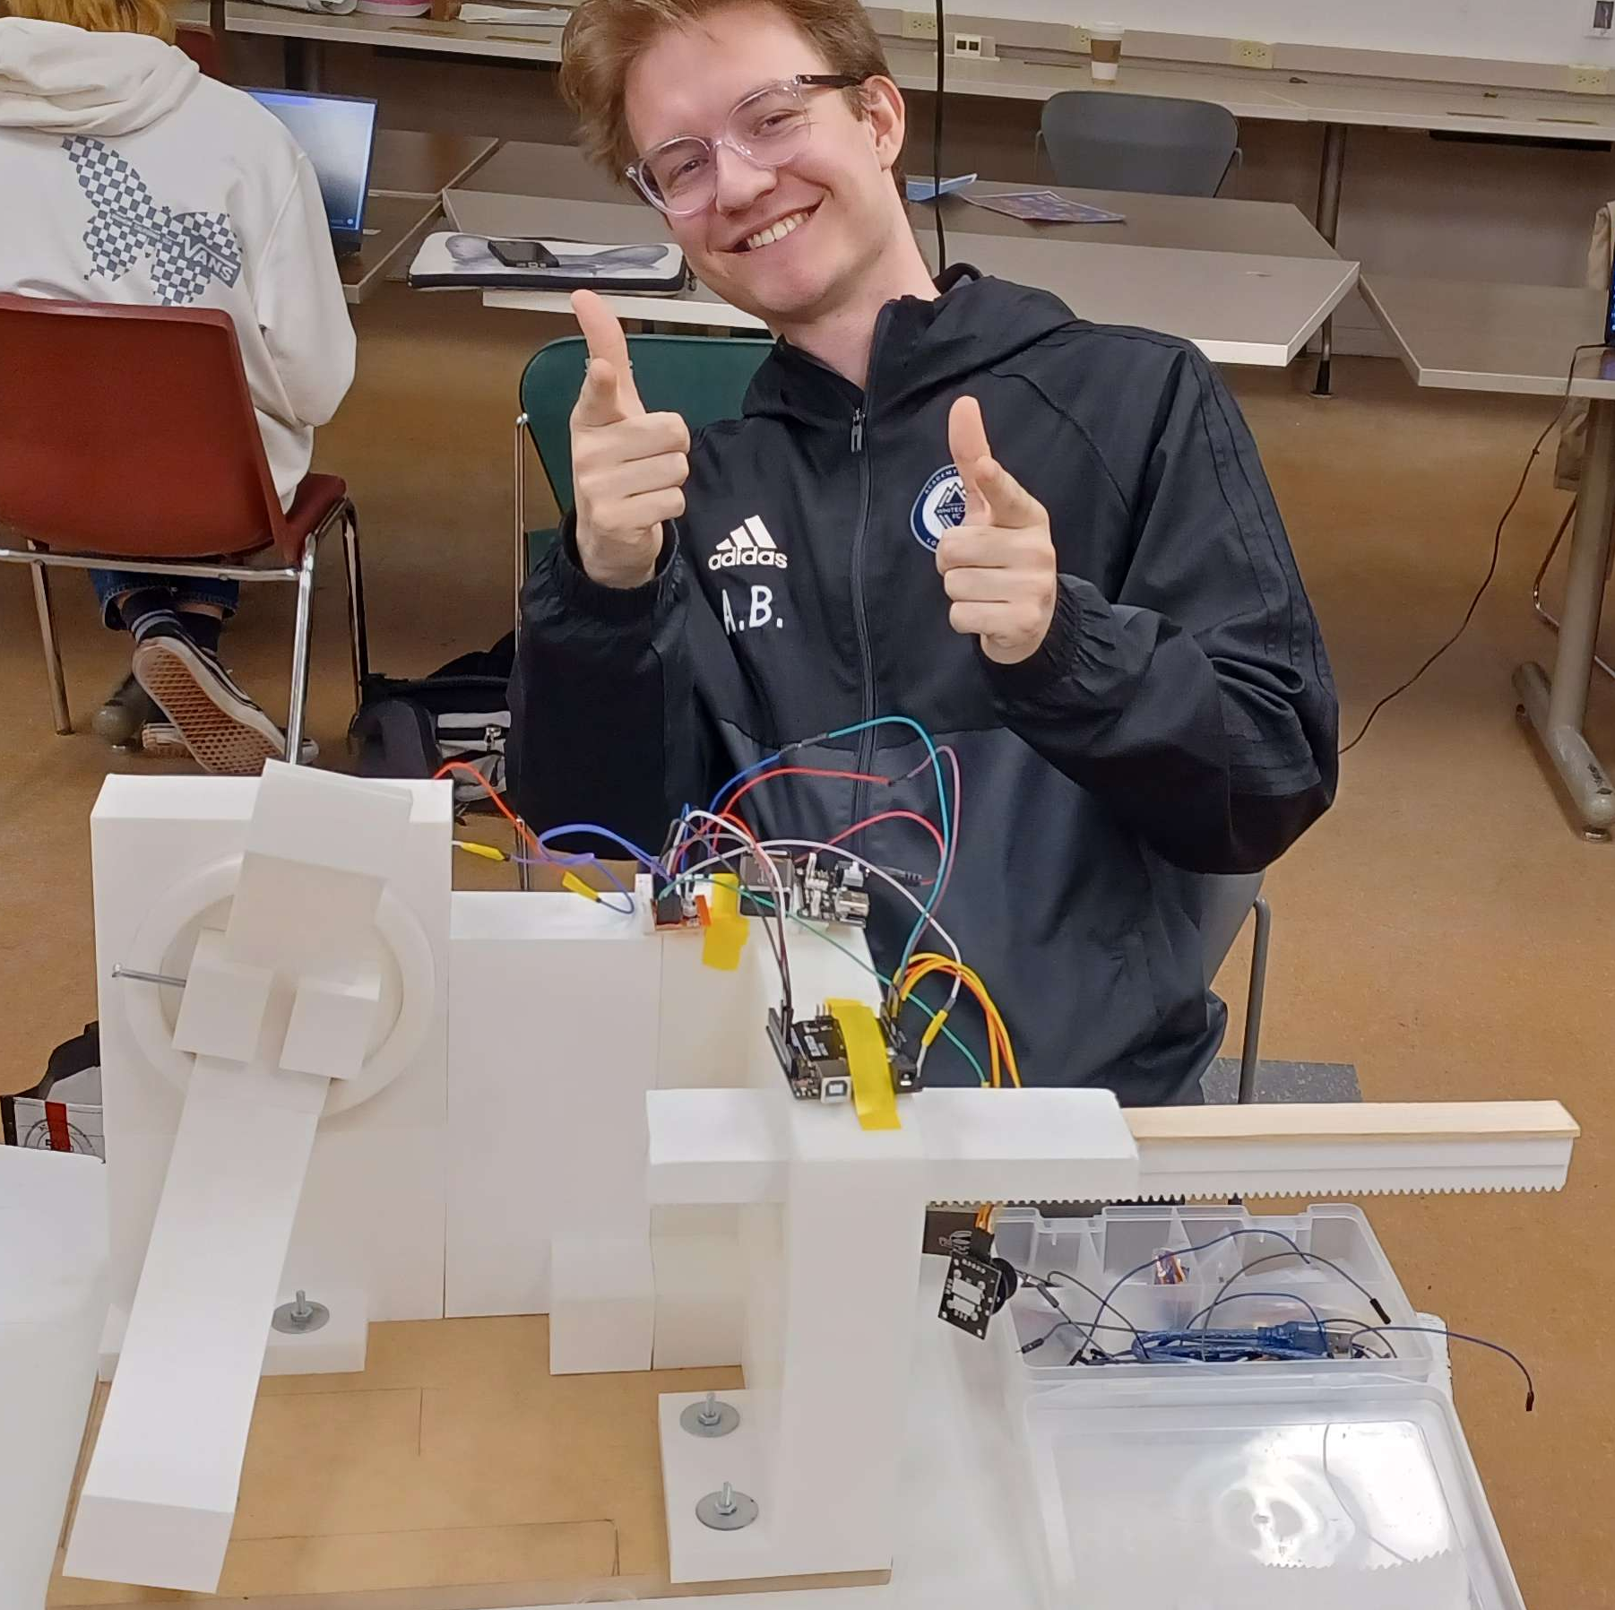
Thankyou

Slide 19





Questions?

